Slide 1


[Social Buzz Analysis]

Slide 2


Today's agenda
Project recap
Problem
The Analytics team
Process
Insights
Summary

Slide 3


The Social Buzz Advisory Engagement is a 3-month project aimed at helping Social Buzz navigate their rapid growth and prepare for an IPO. The project includes
Auditing their big data practices
Offering IPO guidance
Analyzing content categories.
Key tasks include data extraction, data center audit, virtual sessions, technology workshops, stress testing, and documentation. The goal is to demonstrate Accenture's expertise in supporting Social Buzz's scaling efforts and preparing them for a successful IPO.
Project Recap

Slide 4


Problem
Navigate the top 5 most popular categories of content effectively to deliver a successful advisory engagement for Social Buzz

Slide 5



ANDREW FLEMING
Chief Technical Architect
The Analytics team
Marcos Rompton
Senior Principle
Siphosihle Mtshali
Data Analyst

Slide 6

Process
1
UNDERSTANDING PROBLEM
2
CLEANING DATA
3
MINING AND ANALYZING DATA
4
INTERPRETING RESULTS
5
PRESENT FINDINGS

Slide 7


Insights
16
1897
January
UNIQUE
CATEGORIES
REACTIONS TO ANIMAL
CATEGORY
MONTH WITH MOST
POSTS

Slide 8
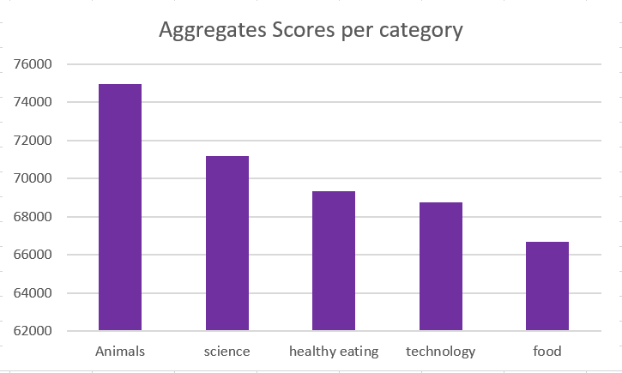

Slide 9
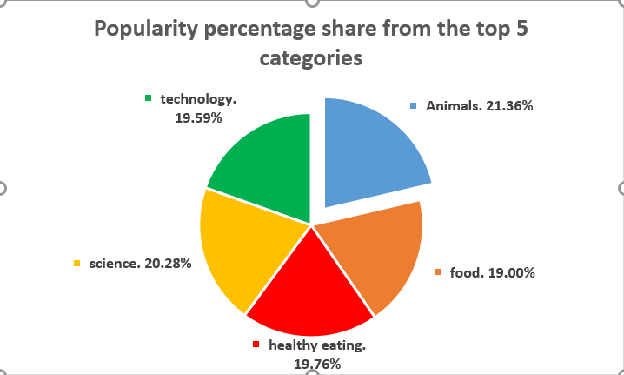

Slide 10


The subject of food enjoys widespread popularity, and within the top five content categories, "Healthy Eating" emerges as the most highly favored among our audience. This valuable insight provides strategic direction for crafting a campaign and establishing partnerships with brands focused on promoting healthy dietary choices, thereby enhancing user engagement
ANALYSIS
A significant portion of the audience demonstrates a strong affinity for two specific content categories, namely, wildlife and scientific topics. They derive great satisfaction from acquiring knowledge pertaining to tangible real-world subjects and factual information.
INSIGHTS
Summary

Slide 11

Thank you!
ANY QUESTIONS?

